Slide 1
Mmmbeth
By Allison Williams
A Set-Pitch

Slide 2
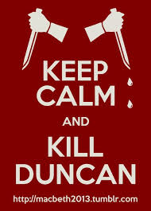
Key Points
Adaptation of Macbeth
Comedy
Slapstick, puns, silly costumes, audience participation
Needs high energy
Main Characters
Witches serve as narrators
Mmmbeth + Lady Mmmbeth

Slide 3
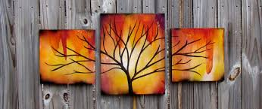
Core Concept of the Set
Time: Modern Day
Use of modern costumes will make life easier
Points where characters break the 4th wall and interact as though they are aware of the performance suggest this
Rotating set pieces that provide a backdrop for the scene at hand.
Tryptic- A term that describes art painted on different canvases (usually 3) but are all part of the same image.

Slide 4
More about the Setting
Each rotating obelisk will have multiple sides to illustrate the 3 main settings in the play
The castle
Brickwork
The heath
Dead trees with muted dreary colors
A TV ad
Bold colors, looks like a TV
Each of these will have a slightly different set up so the entrances and exit paths will have differentiation and will be visually engaging.

Slide 5
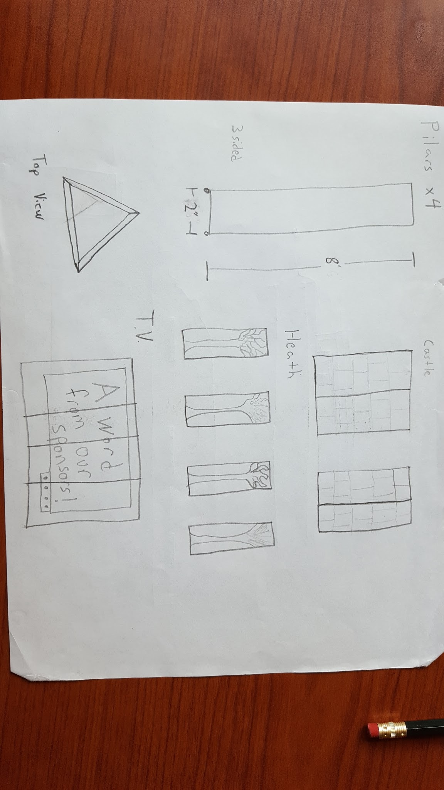
Sketch of Set

Slide 6
Sound and Lighting
Lighting
Lots of changes to show the different scenes
Use of lights on the cyc will also be used for the different scenes
Sound
Any sound cues can be made by actors backstage manually

Slide 7
Expenses
6 4’X8’ sheets of ¾” plywood
2”x4” for framing
Costumes
Largely can be brought in/ searched through the costume closet @ middle school
Props
There are actually a fair bit of these and will need to be created/gathered

