Slide 1
Spoken Word Poetry
The new form of storytelling

Slide 2
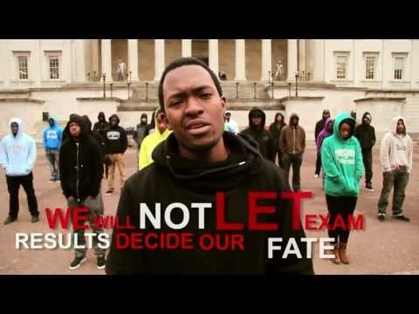
Spoken Word Poetry is different
Spoken Word is not like the standard poetry that you learn about in ELA
It has soul and feeling that is easily identifiable

Slide 3
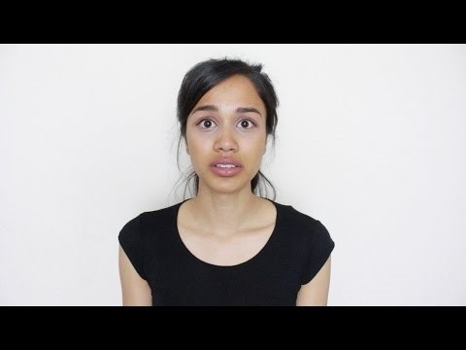
Spoken Word
Maybe it is easier to understand what it is not.
Spoken Word is not structured
Spoken Word is not prescriptive
Spoken Word is not made to be read, but heard.

Slide 4
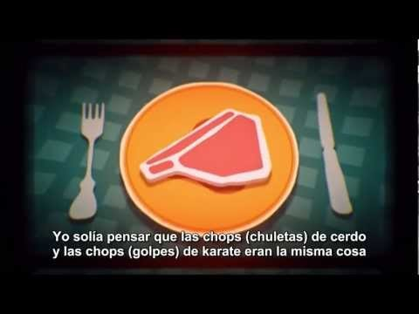
Content
Spoken word is often about something important
Most are often about “big issues”
Does not have to be, but usually is.

Slide 5
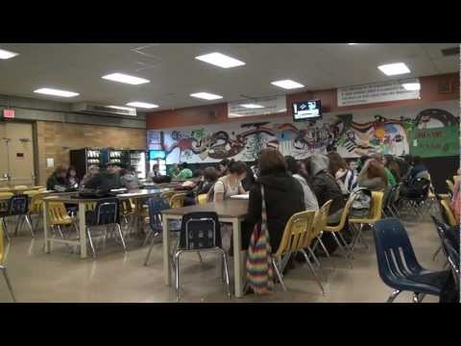
Rhythm
Has a definite style and beat
Beat can change throughout the poem
Beat is used to add to the poem either by showing emphasis, or by adding alliteration
Not prescribed form like sonnets
Breaks in rhythm can be used as well

Slide 6
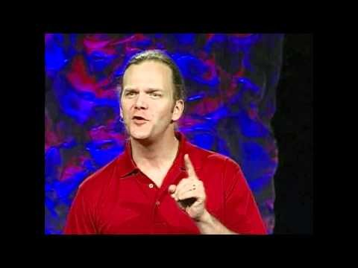
Pace
Some poems are delivered fast
Some are delivered slow
The good ones make use of changes in speed and pauses to add emphasis

Slide 7
Your assignment
We are going to be working with Spoken Word for the rest of the term.
Your first assignment will be to choose a Spoken Word piece from a selection that I have provided for you.
We are working on identifying the rhythm and pace that is typical of this style of storytelling.
Performances will be on Thursday/Friday

